Slide 1
Multiple Integral
Chapter 14

Slide 2
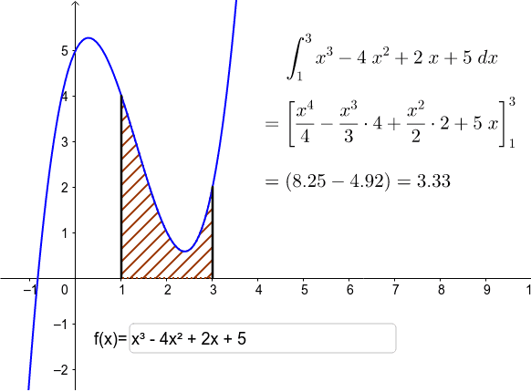
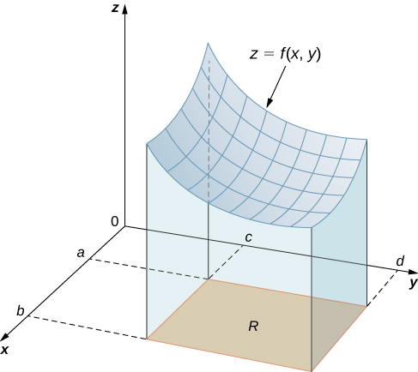
Technique of integration

Slide 3

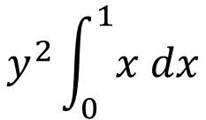
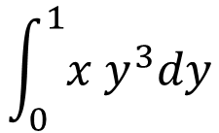

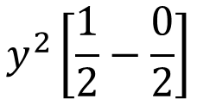
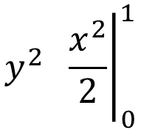
$$y^{2}\int_{0}^{1}{x dx}$$
$$\int_{0}^{1}{x y^{3}dy}$$
$$y^{2} { \left.\frac{x^{2}}{2}\right|}_{0}^{1}$$
$$y^{2}\left[\frac{1}{2}−\frac{0}{2}\right]$$
$$\frac{y^{2}}{2}$$

Slide 4

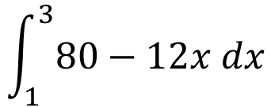

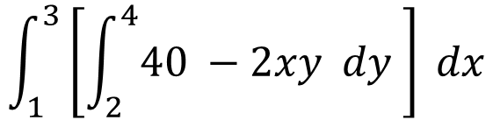
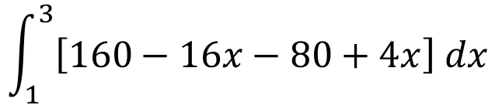

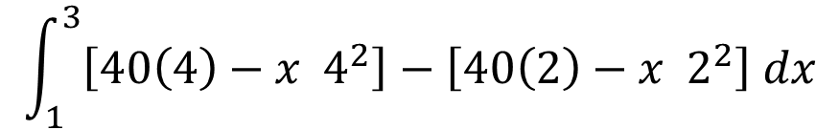

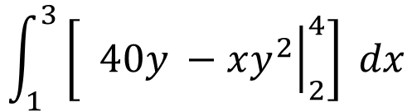
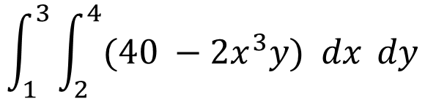
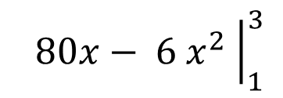
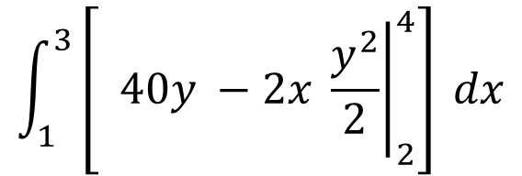
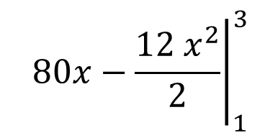

$$\int_{1}^{3}{80−12x dx}$$
$$\int_{1}^{3}{\left[\int_{2}^{4}{40 −2xy dy }\right] dx}$$
$${ \left.80x−\frac{12 x^{2}}{2}\right|}_{1}^{3}$$
$$\int_{1}^{3}{\left[{ \left.40y −2x \frac{y^{2}}{2}\right|}_{2}^{4}\right] dx}$$
$${ \left.80x− 6{ x}^{2} \right|}_{1}^{3}$$
$$\left[80\left(3\right)−6(3^{2})\right]−\left[80\left(1\right)−6(1^{2})\right]$$
$$\int_{1}^{3}{\left[{ \left.40y −xy^{2}\right|}_{2}^{4}\right] dx}$$
$$\left[240−54\right]−\left[80−6\right]$$
$$\left[186\right]−\left[74\right]$$
$$\int_{1}^{3}{\left[40\left(4\right)−x 4^{2}\right]−\left[40\left(2\right)−x 2^{2}\right] dx}$$
$$112$$
$$\int_{1}^{3}{\left[160−16x−80+4x\right] dx}$$
$$\int_{1}^{3}{\int_{2}^{4}{(40 −2x^{3}y) dx }dy}$$

Slide 5
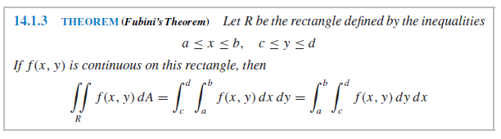

Slide 6
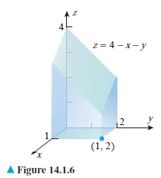






Slide 7
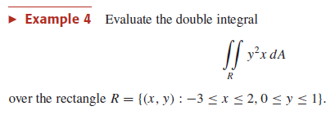







Slide 8

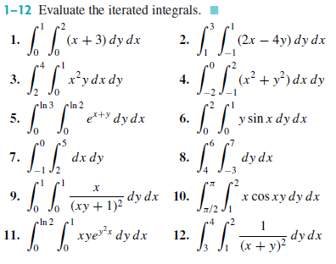

Slide 9
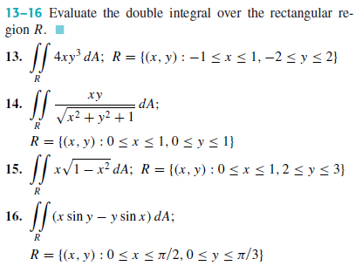

Slide 10
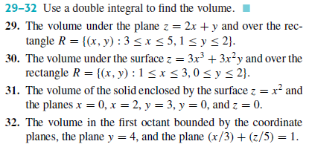

Slide 11


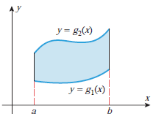



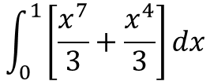
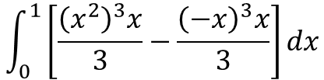
$$\int_{0}^{1}{\left[\frac{{\left(x^{2}\right)}^{3}x}{3}−\frac{{\left(−x\right)}^{3}x}{3}\right]}dx$$
$$\int_{0}^{1}{\left[\frac{x^{7}}{3}+\frac{x^{4}}{3}\right]}dx$$

Slide 12
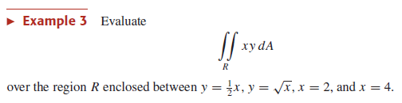
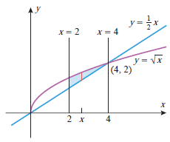








Slide 13
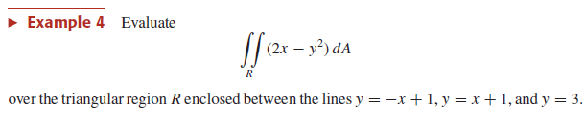



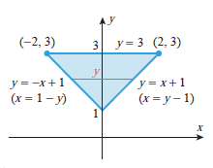











Simultaneous solution
$$y=−x+1$$
$$x=−y+1$$
$$y=1$$
$$y−1=−y+1$$
$$y=x+1$$
$$x=y−1$$
$$y=3$$
$$y=3$$

Slide 14

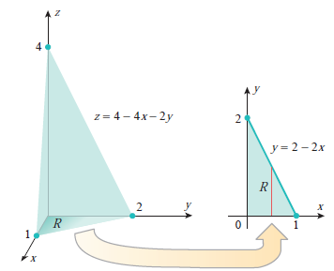













$$coordinate planes are$$
$$x=0$$
$$y=0$$
$$x=1$$
$$z=0$$
$$0=4−4x−2y$$
$$y=2−2x$$
$$z=4−4x−2y$$

Slide 15

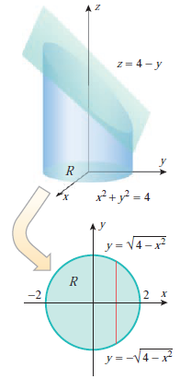
















$$y+z=4$$
$$z=4−y$$
$$y=+\sqrt{4−x^{2}}$$
$$x^{2}+y^{2}=4$$
$$y=±\sqrt{4−x^{2}}$$
$$y=−\sqrt{4−x^{2}}$$
$$\sqrt{4−x^{2}}=−\sqrt{4−x^{2}}$$
$$2\sqrt{4−x^{2}}=0$$
$$4−x^{2}=0$$
$$x^{2}=4$$
$$x=±2$$

Slide 16
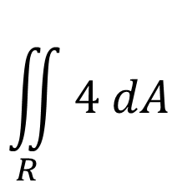

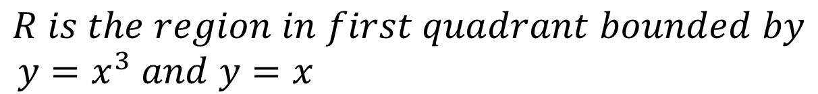
$$\iint_{R}{4 dA}$$
$$Evaluate double integral$$
$$R is the region in first quadrant bounded by$$
$$y=x^{3} and y=x$$

Slide 17

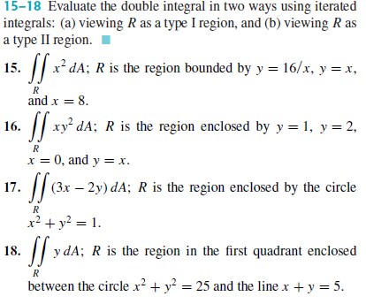
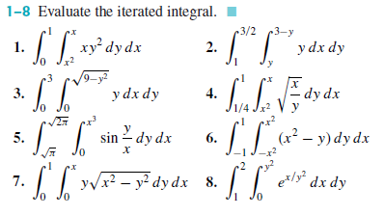

Slide 18
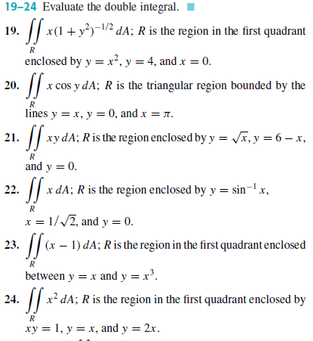
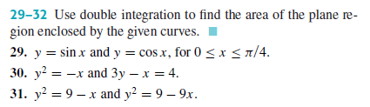

Slide 19
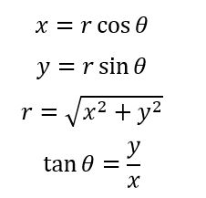
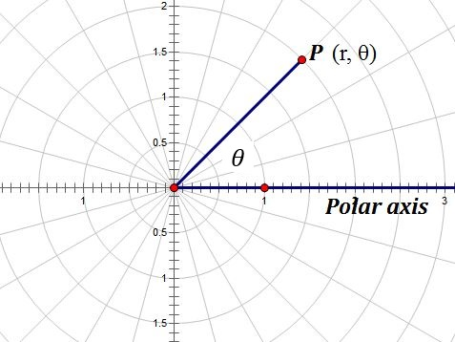

Polar Coordinate
$$r=r(θ)$$

Slide 20
Polar Plot

Slide 21
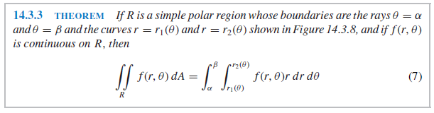

Slide 22

Cardioid Function
$$r=(1+cosθ)$$

Slide 23
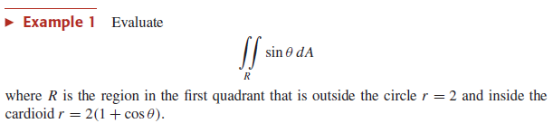
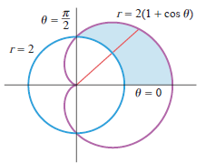




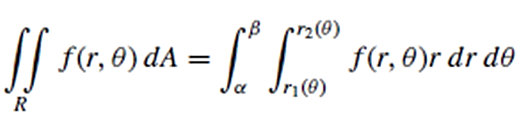



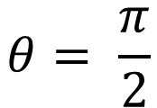




$$2=2(1+cosθ)$$
$$1=1+cosθ$$
$$0=cosθ$$
$${Cos}^{−1}(0)=θ$$
$$θ= \frac{π}{2}$$
$$\frac{3π}{2}$$
$$\frac{5π}{2}$$

Slide 24
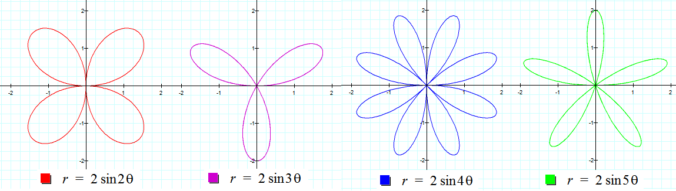





Rose curve Plot
$$Sin2θ →4 Petals$$
$$r=Sin 2θ$$
$$Sin3θ →3 Petals$$
$$Sin4θ →8 Petals$$
$$Sin5θ →5 Petals$$

Slide 26

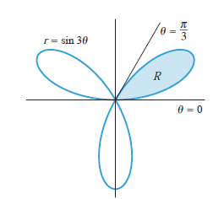


















$$0=Sin3θ$$
$${Sin}^{−1}(0)=3θ$$
$$3θ=0$$
$$π$$
$$2π$$
$$3π$$
$$θ=0$$
$$\frac{π}{3}$$
$$\frac{2π}{3}$$
$$π$$
$$Sin3θ →3 Petals$$
$$For 3 petals$$

Slide 27

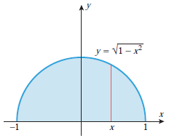



Slide 28

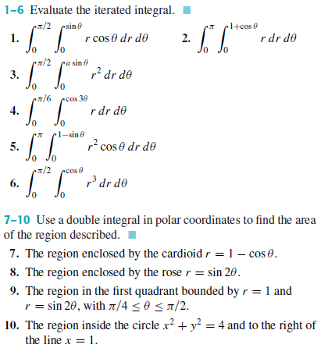

Slide 29
Triple Integral

Slide 30
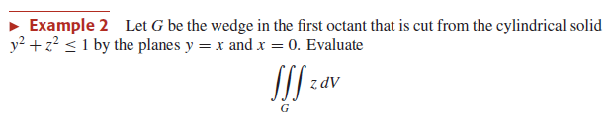











$$y^{2}+z^{2}≤1$$
$$z≤±\sqrt{1−y^{2}}$$
$$z=\sqrt{1−y^{2}}$$

Slide 31











Slide 32
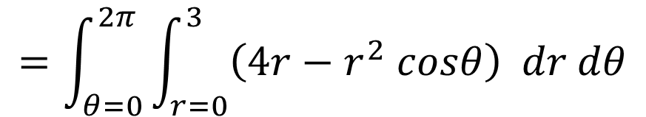
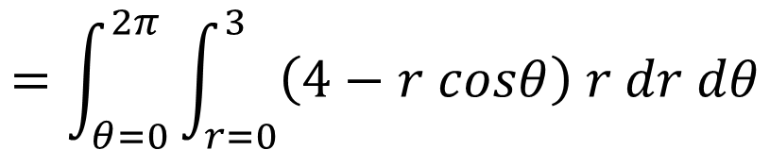



$$=\int_{θ=0}^{2π}{\int_{r=0}^{3}{\left(4r−r^{2} cosθ\right) dr dθ}}$$
$$=\int_{θ=0}^{2π}{\left[{ \left.\frac{4r^{2}}{2}−\frac{r^{3}}{3} cosθ\right|}_{0}^{3}\right]dθ}$$
$$=\iint_{R}{\left(4−x\right)dA}$$
$$=\int_{θ=0}^{2π}{18−9cosθ dθ}$$
$$=\int_{θ=0}^{2π}{\int_{r=0}^{3}{\left(4−r cosθ\right) r dr dθ}}$$

Slide 33



